Slide 1
Programming with Java
Anan Yaagoub - PhD
Northwestern University

Slide 2
Week 3 - Agenda
OOP
  Inheritance, Polymorphism, abstract, and interface.
  Static, generic, and auto-boxing.
  Special overrides (toString, equals, hashCode) and Comparable interface.
Built-ins objects
  Core libraries
  Third party libraries – JAR files
Collection Framework in Java
  List
  Set
  Map
  Sort and Search in Java

Slide 3
Part I

Slide 4
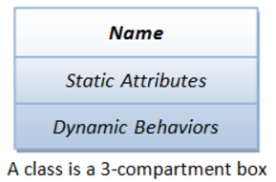
OOP – Class/Object
The basic unit of OOP is a class, which encapsulates
  Data -- properties and (object state)
  Methods -- dynamic operations.
  OOP combines the data structures and algorithms of a software entity inside the same box.

Slide 5
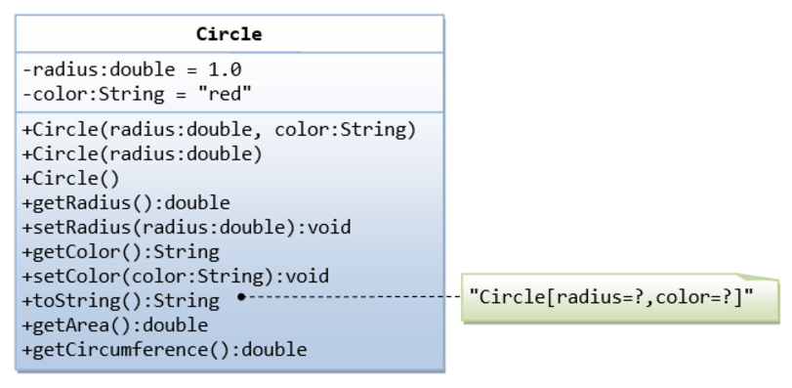
Programming Example - Circle
Encapsulation
Constructor(s)
Overloading
Private/Public
Setters/Getters
Overrides

Slide 6
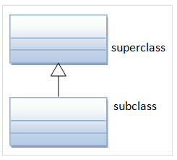
Inheritance
Use extends
organize classes in hierarchy to avoid duplication and reduce redundancy.
The classes in the lower hierarchy inherit all the variables (static attributes) and methods (dynamic behaviors) from the higher hierarchies.
A class in the lower hierarchy is called a subclass (or derived, child, extended class).
A class in the upper hierarchy is called a superclass (or base, parent class).

Slide 7

Inheritance - rules
Keyword "super“ - refers to the superclass
  access superclass methods and variables within the subclass definition.
  super() and super(argument-List) can be used invoke the superclass constructor.
Default no-arg Constructor
Single Inheritance
  Java does not support multiple inheritance (C++ does).
Common Root Class - java.lang.Object
  All Java classes are derived from a common root class called java.lang.Object.

Slide 8
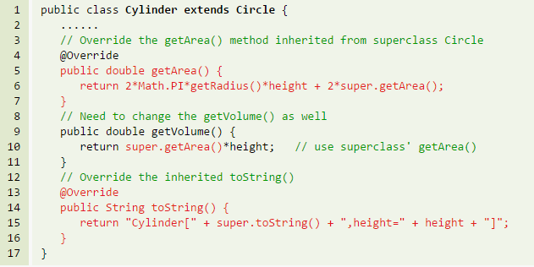
Inheritance - Overriding & Hiding
A subclass can:
  use the inherited methods and variables as they are.
  override an inherited method by providing its own version.
  hide an inherited variable by defining a variable of the same name.
  The "@Override" is annotation - asks compiler to check whether there is such a method in the superclass to be overridden -misspell

Slide 9
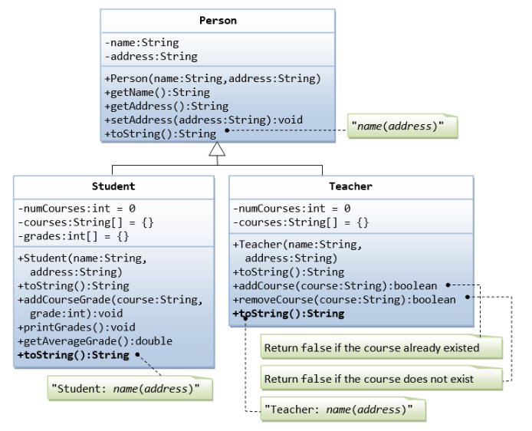
Inheritance - Example

Slide 10
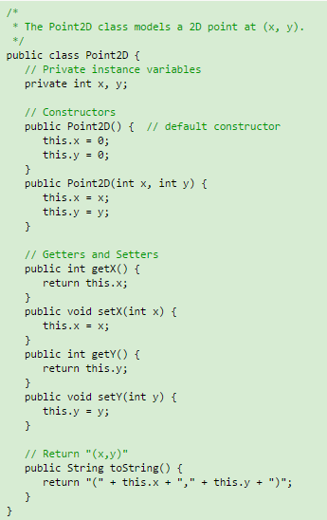
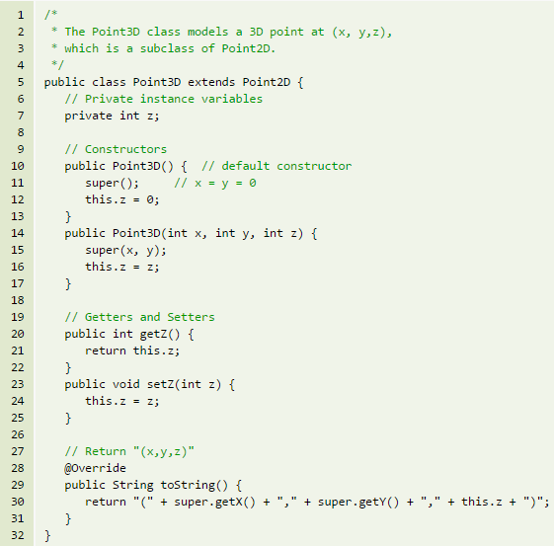
Inheritance - Example

Slide 11
Polymorphism
Basically, polymorphism means that an instance of an class (an object) can be used as if it were of different types.
A subclass possesses all the attributes and operations of its superclass.
  This means that a subclass object can do whatever its superclass can do.
  As a result, we can substitute a subclass instance when a superclass instance is expected, and everything shall work fine.

Slide 12
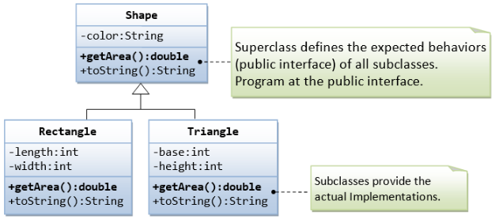
Polymorphism …
A subclass instance can be assigned (substituted) to a superclass' reference.
Once substituted, we can invoke methods defined in the superclass; we cannot invoke methods defined in the subclass.
However, if the subclass overrides inherited methods from the superclass, the subclass (overridden) versions will be invoked.

Slide 13
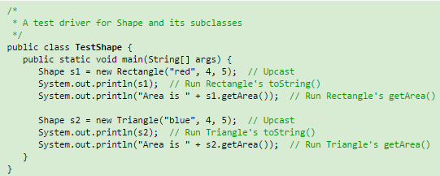
Polymorphism – example …
Example (inheritance and polymorphism) : Ex1_...java

Slide 14
"Is-a" vs. "has-a" relationships
"Is-a" relationship: A subclass object processes all the data and methods from its superclass (and it could have more). We can say that a subclass object is-a superclass object (is more than a superclass object). Refer to "polymorphism".
"has-a" relationship: In composition, a class contains references to other classes, which is known as "has-a" relationship.
You can use "is-a" and 'has-a" to test whether to design the classes using inheritance or composition.

Slide 15
Part II

Slide 16
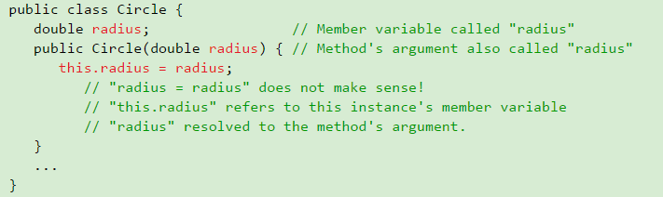

super & this & toString()
super keyword and super() method
Keyword "this"
Method toString()

Slide 17
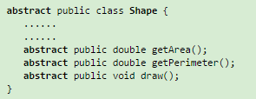
Abstract Classes & Methods
An abstract method is a method with only signature (i.e., the method name, the list of arguments and the return type) without implementation (i.e., the method’s body).
You use the keyword abstract to declare an abstract method.
For example:
A class containing one or more abstract methods is called an abstract class.
An abstract class must be declared with a class-modifier abstract.
An abstract class CANNOT be instantiated, as its definition is not complete.
Example: Ex2_AbstractDemo.java

Slide 18
Abstract Classes & Methods
Notes:
  An abstract method cannot be declared final, as final method cannot be overridden.
  An abstract method, on the other hand, must be overridden in a descendant before it can be used.
  An abstract method cannot be private (which generates a compilation error). This is because private method are not visible to the subclass and thus cannot be overridden.
In summary, an abstract class provides a template for further development.

Slide 19
The Java's interface
Java interfaces are a way to achieve polymorphism
A Java interface is a 100% abstract superclass which define a set of methods its subclasses must support.
An interface contains only public abstract methods (methods with signature and no implementation) and possibly constants (public static final variables).
You have to use the keyword "interface" to define an interface (instead of keyword "class" for normal classes). The keyword public and abstract are not needed for its abstract methods as they are mandatory.
Similar to an abstract superclass, an interface cannot be instantiated. You have to create a "subclass" that implements an interface, and provide the actual implementation of all the abstract methods.

Slide 20
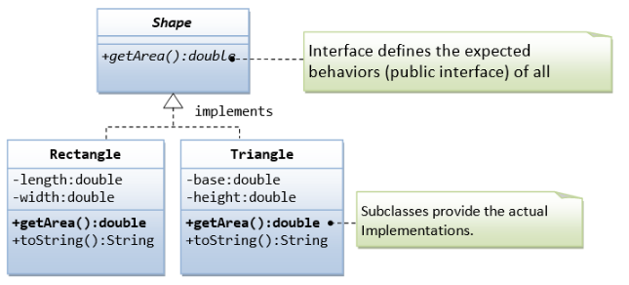
interface - example
Shape is an interface

Slide 21
The Java's interface …
Unlike a normal class, where you use the keyword "extends" to derive a subclass. For interface, we use the keyword "implements" to derive a subclass.
An interface is a contract for what the classes can do. It, however, does not specify how the classes should do it.
In Java, abstract class and interface are used to separate the public interface of a class from its implementation so as to allow the programmer to program at the interface instead of the various implementation.

Slide 22
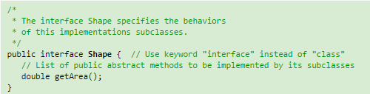
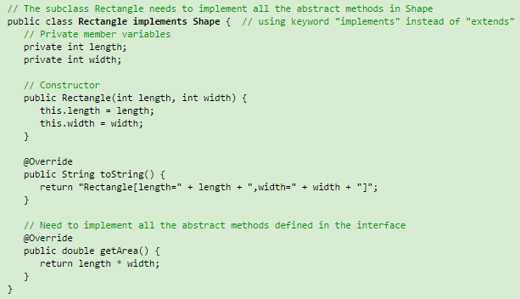
interface …

Slide 23

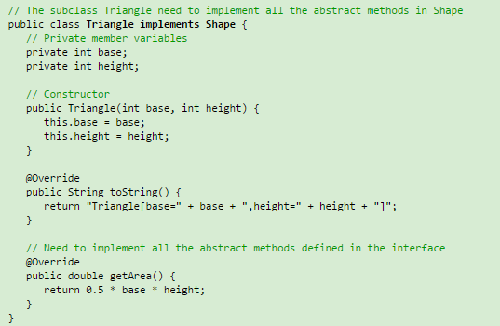
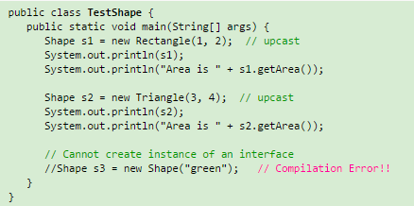
interface …

Slide 24
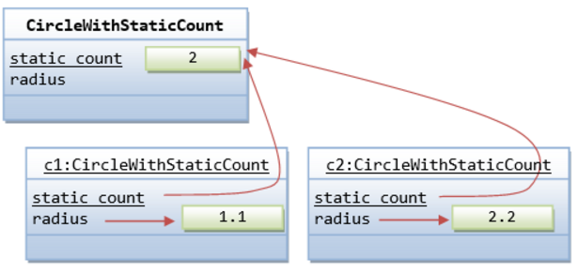
The "static" Variables and Methods
You can apply modifier "static" to variables and methods.
A static variable/method belongs to the class, and is shared by all instances. Called class variable/method
a non-static variable/method (absence of keyword static) belongs to a specific instance of a class, also called an instance variable/method.

Slide 25
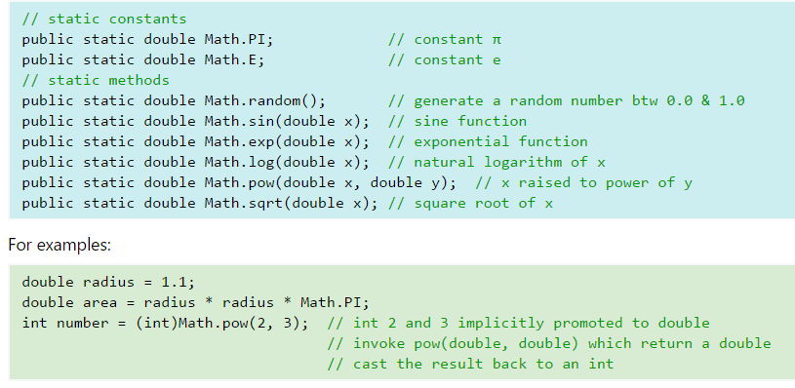
static Method
Example: java.lang.Math - Mathematical Functions & Constants
No Need for instantiation
Example: Ex3_MortgagePaymentCalculator.java
Example: Ex4_Employee.java

Slide 26
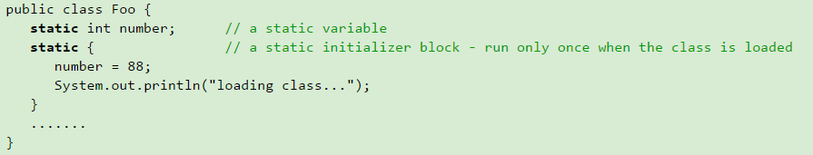
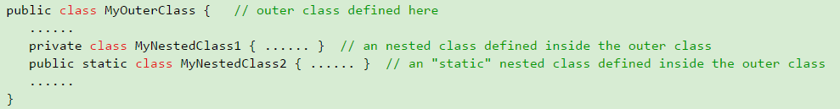
More …
Static Initializer
Nested (Inner) Classes

Slide 27
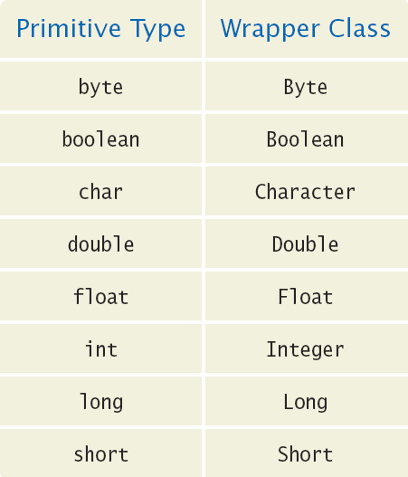
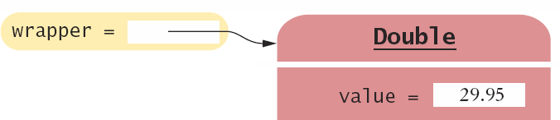
Wrappers and Auto-boxing
Java provides wrapper classes for primitive types
  Conversions are automatic using auto-boxing
    Primitive to wrapper Class
    Wrapper Class to primitive
double x = 29.95;
Double wrapper;
wrapper = x; // boxing
double x;
Double wrapper = 29.95;
x = wrapper; // unboxing

Slide 28
Wrappers and Auto-boxing
You cannot use primitive types in an ArrayList, but you can use their wrapper classes
Declare the ArrayList with wrapper classes for primitive types
  Use ArrayList<Double>
    Add primitive double variables
    Or double values
double x = 19.95;
ArrayList<Double> values = new ArrayList<Double>();
values.add(29.95); // boxing
values.add(x); // boxing
double x = values.get(0); // unboxing

Slide 29
Generic
Generics is a compiler mechanism whereby you can create (and use) types of things (such as classes or interfaces, and methods) in a generic fashion by harvesting the common code and parameterizing(or templatizing) the rest.
This approach to programming is called generic programming.
The most commonly used type parameter names are:
  E - Element (used extensively by the Java Collections Framework)
  K - Key
  N - Number
  T - Type
  V – Value
  Or whatever you choose

Slide 30
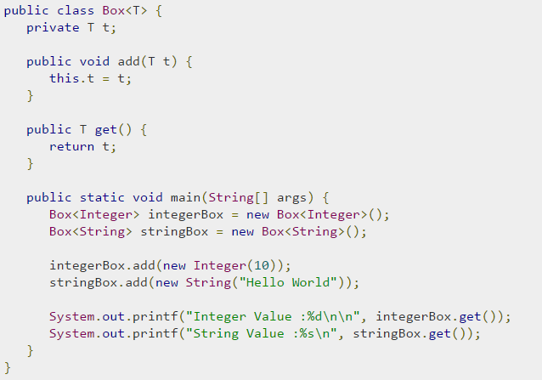
Generic Classes
A generic class declaration looks like a non-generic class declaration,
except that the class name is followed by a type parameter section.
As with generic methods, the type parameter section of a generic class can have one or more type parameters separated by commas.
Methods can be generic
Code Example: Ex5_ElementCount.java

Slide 31
Comparisons
Primitive data type comparison: ==; <; <=; >; >=; !=
Strings: use .equals()
Strings s1 < s2 // not allowed
Objects: must override equals
Objects: must implement Comparable interface
Comparable Interface has one method:
  public int compareTo(AnotherClass x)
Example:Ex6_Student.java

Slide 32
Search and Sort in Java
Sorting
  Arrays class contains a static method sort()
  Sorts integers and floating numbers
  Uses quicksort algorithm
  Collections also have a sort method
  It can be used with ArrayList and other types (implement collection)
Search
  Arrays and Collections has static binarySearch methods
  Implement binary search algorithm
  Enhanced: returns (– position) if not found
Comparing Objects
  Implement the Comparable interface
Example: Ex7_SearchSortTest.java

